Slide 1
L1 (CHAPTER 2) Data Representation Exercises
Acknowledgement: some slides taken from Yifeng Zhu’s courseware

Slide 2
Question: Endianness
Q: Assume Big Endian ordering. If a 32-bit word resides at memory address N, what is the address of:
(a) The MSB (Most Significant Byte)
(b) The 16-bit half-word corresponding to the most significant half of the word
Q: Redo the question assuming Little Endian ordering.
N+3
LSB
N+2
Big-Endian
N+1
N
MSB
N+3
MSB
N+2
Little-Endian
N+1
N
LSB

Slide 3
Question: Endianness
32-bit
Words
Bytes
Addr.
0015
Addr
=
??
0014
Word 3
0013
0012
What are the memory address of these four words?
0011
Addr
=
??
0010
Word 2
0009
0008
0007
Addr
=
??
0006
Word 1
0005
0004
0003
Addr
=
??
0002
Word 0
0001
0000

Slide 4
Question: Endianness
The word stored at address 0x20008000
with Big-Endian ordering is
Memory Address | Memory Data
0x20008003 | 0xA7
0x20008002 | 0x90
0x20008001 | 0x8C
0x20008000 | 0xEE
?
The word stored at address 0x20008000
with Little-Endian ordering is
?
Notes:
Halfword access and signed halfword/byte accesses were added to the architecture in v4T, this is the reason the offset field is not as flexible as the normal word/byte load/store - not a problem because these accesses are less common.
Link: diagram on next slide

Slide 5
Data Alignment
Review
Assume a byte-addressable memory with a data bus that is 32 bits (4 bytes) wide
Consider 16 bytes of memory (addresses 0 to 15) arranged as four 32-bit words (4 bytes each)
Well-aligned: each word begins on a mod-4 address, which can be read in a single memory cycle
Ill-aligned: a word begins on address 6, not a mod-4 address, which can be read in 2 memory cycles
The first read cycle would retrieve 4 bytes from addresses 4 through 7; of these, the bytes from addresses 4 and 5
are discarded, and those from addresses 6 and 7 are moved to the far right;
The second read cycle retrieves 4 bytes from addresses 8 through 11; the bytes from addresses 10 and 11 are discarded, and those from addresses 8 and 9 are moved to the far left;
Finally, the two halves are combined to form the desired 32-bit operand:

Slide 6
Question: Data Alignment
Q: Assume a byte-addressable memory with a data bus that is 32 bits (4 bytes) wide. Consider 16 bytes of memory (addresses 0 to 15) arranged as four 32-bit words (4 bytes each).
(a) What is the address of the most significant byte of the word at address 102, , assuming Little-Endian ordering?
(b) What is the address of the most significant byte of the word at address 102, , assuming Little-Endian ordering?
(b) How many memory cycles are required to read the word at address 102?
(c) How many memory cycles are required to read the half word at address 102?

Slide 7
Question: Data Alignment
Q: Assume a byte-addressable memory with a data bus that is 32 bits (4 bytes) wide. Consider 16 bytes of memory (addresses 0 to 15) arranged as four 32-bit words (4 bytes each). How many memory cycles are required to read each of the following from memory?
(a) A 2-Byte operand read from decimal address 5
(b) A 2-Byte operand read from decimal address 15
(c) A 4-Byte operand read from decimal address 10
(d) A 4-Byte operand read from decimal address 20

Slide 8
Question: Memory Cycles
Q: Assume a byte-addressable memory with a data bus that is 32 bits (4 bytes) wide.
It takes ____ memory cycle(s) to read a Byte from memory
It takes ____ memory cycle(s) to read a half-word from memory
It takes ____ memory cycle(s) to read a word from memory
It takes ____ memory cycle(s) to read a double word from memory

Slide 9
Question: Arrays
Q: If the first element of a one-dimensional array x[] is located in memory at address 0x12345678, what will be the address of the second element if the array x[] contains
(a) chars
(b) shorts
(c) ints
(c) longs

Slide 14
Decimal, Binary and Hex
Review
Decimal | Binary | Hex
0 | 0000 | 0x0
1 | 0001 | 0x1
2 | 0010 | 0x2
3 | 0011 | 0x3
4 | 0100 | 0x4
5 | 0101 | 0x5
6 | 0110 | 0x6
7 | 0111 | 0x7
8 | 1000 | 0x8
9 | 1001 | 0x9
10 | 1010 | 0xA
11 | 1011 | 0xB
12 | 1100 | 0xC
13 | 1101 | 0xD
14 | 1110 | 0xE
15 | 1111 | 0xF
Prefix 0x denotes hex

Slide 15
Question: Number Conversion
Q: Convert 0x3A56E2F8 into binary
Q: Convert binary number 0011 1010 into hex
0x3A
Decimal | Binary | Hex
0 | 0000 | 0x0
1 | 0001 | 0x1
2 | 0010 | 0x2
3 | 0011 | 0x3
4 | 0100 | 0x4
5 | 0101 | 0x5
6 | 0110 | 0x6
7 | 0111 | 0x7
8 | 1000 | 0x8
9 | 1001 | 0x9
10 | 1010 | 0xA
11 | 1011 | 0xB
12 | 1100 | 0xC
13 | 1101 | 0xD
14 | 1110 | 0xE
15 | 1111 | 0xF

Slide 16
Adding two integers
Review
-9
+
6
9
flip
+1
-9
1 | 0 | 1 | 1 | 1
0 | 0 | 1 | 1 | 0
01001
10110
10111
23
6
Two’s Complement
Hardware Adder
29
flip
+1
3
1 | 1 | 1 | 0 | 1
00010
00011
Two’s Complement Counterpart
-3
Same bit patterns, different interpretation.
Unsigned addition: 23+6=29
Signed addition: -9+6=-3
This example shows that the hardware adder for adding unsigned numbers, also works correctly for adding signed numbers.
Notes:
{{Pause=1}} We will use a very simple example to show that, the hardware adder for adding unsigned numbers, also works correctly for adding signed numbers. {{Pause=0.5}}
Suppose we are adding negative nine and six. {{Pause=0.5}} These two signed numbers are represented in two’s complement in computers. {{Pause=0.5}}
Specifically, we can obtain the two’s complement representation of negative nine by flipping all bits and adding one. {{Pause=0.5}} The two’s complement of a positive number is itself. {{Pause=0.5}}
Let’s see what will happen if the hardware treats these two inputs as unsigned numbers. If these binary bits represent unsigned numbers, they are 23 and 6, respectively. Therefore, the hardware adds 23 and 6, and produces 29, in decimal, {{Pause=0.3}} or one, one, one, zero, one, in binary. {{Pause=0.5}}
If the output represents a signed integer in two’s complement, it actually represents negative 3. This can be proved by inverting all the bits and adding one. The result, negative three, is exactly the sum of the original signed inputs. {{Pause=0.5}}
This example shows that, without any modification, the hardware adder designed for adding unsigned numbers, works correctly for adding signed numbers.

Slide 17
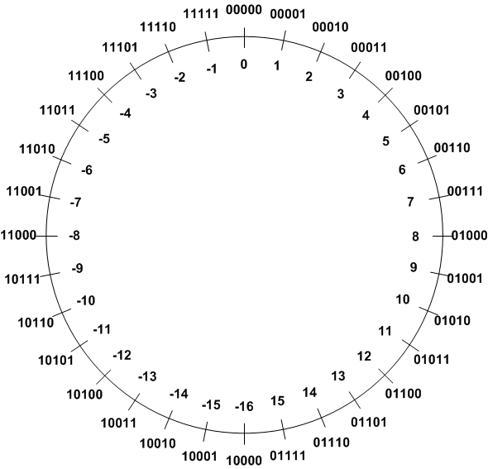
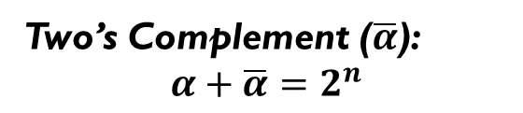
Signed Integers Method 3: Two’s Complement
Review
Two’s Complement ($\overline{α}$):
$$α+\overline{α}=2^{n}$$
TC of a number can be obtained by its bitwise NOT plus one.
Example 1: TC(3)
 | Binary | Decimal
Original number | 00011 | 3
Step 1: Invert every bit | 11100
Step 2: Add 1 | + 00001
Two’s complement | 11101 | -3

Slide 18

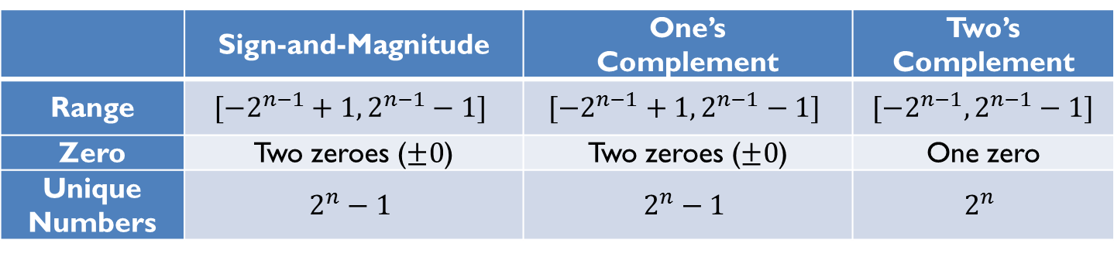
Signed Integer Representation Overview
Review
Three ways to represent signed binary integers:
Signed magnitude
$value={(−1)}^{sign}×Magnitude$
One’s complement ($\tilde{α}$)
$α+\tilde{α}=2^{n}−1$
Two’s complement ($\overline{α}$)
$α+\overline{α}=2^{n}$
 | Sign-and-Magnitude | One’s Complement | Two’s Complement
Range | $$[−2^{n−1}+1, 2^{n−1}−1]$$ | $$[−2^{n−1}+1, 2^{n−1}−1]$$ | $$[−2^{n−1}, 2^{n−1}−1]$$
Zero | Two zeroes ($±0$) | Two zeroes ($±0$) | One zero
Unique Numbers | $$2^{n}−1$$ | $$2^{n}−1$$ | $$2^{n}$$

Slide 19
Question: 2’s Complement
For each of the following binary numbers in a 8-bit system, give the corresponding binary number of the negative of its value, for 2’s-complement system
(a) x=01010101
TC(x)=10101011
(b) x=10101010
TC(x)=01010110
(c) x=10000000
TC(x)=10000000

Slide 20
Question: Number Conversion
Q: What is the decimal value of binary number x=10100111 as either unsigned int, or signed int in 2’s complement representation?
Unsigned int: 2^7+2^5+2^2+2^1+2^0= 167
Signed int: 10100111=-89 flip 01011000 add 1 01011001=89
01011001 flip 10100110 add1 10100111
What about x=11100001?
Unsigned int: 225 = 2^7+2^6+2^5+2^0=
Signed int: 00011110 + 1 = 00011111 = 31 so 11100001 = -31
What about x=10000000?
Unsigned int: 128
Signed int:-128

Slide 21
Question: Number Conversion
Q: Which number is larger: 1001 or 0011 in binary?
If unsigned int: 1001
If signed int: 1001=-7 0011=3
0111 = 7
Q: Which number is larger: 0xFFFFFFFF or 0x00000001 in hex?
If unsigned int: 0xFFFFFFFF=2^32 – 1 0x00000001=1
If signed int: 0xFFFFFFFF= 111111111111111111111 =-1
invert: 0x00000000 add1: 0x00000001
0x00000001=1

Slide 22
Question: Number Range
Which range of decimals can be expressed with a 6-bit signed number (assuming Two’s complement representation)?
Answer | Range
A | -32 … 32
B | -64 … 63
C | -31 … 32
D | -16 … 15
E | -32 … 31

Slide 23
Question: Number Range
Which range of decimals can be expressed with a 6-bit unsigned integer?
Answer | Range
A | -32 … 32
B | -64 … 63
C | -31 … 32
D | -16 … 15
E | -32 … 31

Slide 24
Question: Integer arithmetic
Q: Consider a 4-bit system. What is the result of 1001 + 0011?
1001 + 0011 = 1100
Unsigned: 9+3=12
Signed:-7+3=-4

Slide 25
Summary of Carry and Overflow Flags
Review
Bit | Name | Meaning after add or sub
N | negative | result is negative
Z | zero | result is zero
V | overflow | signed overflow
C | carry | unsigned overflow
Carry flag C = 1 upon an unsigned addition if the answer is wrong (true result > 2^{n}-1)
Carry flag C = 0 (Borrow flag = 1) upon an unsigned subtraction if the answer is wrong (true result < 0)
Overflow flag V =1 upon a signed addition if the answer is wrong (true result > 2^{n-1}-1 or true result < -2^{n-1})
31
0
N
Z
C
V
25
CPSR (Current Program Status Register)
Notes:
C is cleared upon an unsigned subtract if the answer is wrong

Slide 26
Signed or unsigned
Review
Whether the carry flag or the overflow flag should be used depends on the programmer’s intention.
uint a;
uint b;
…
c = a + b
…
int a;
int b;
…
c = a + b
…
C Program
C Program
Check the carry flag
for unsigned addition
Check the overflow flag
for signed addition

Slide 27
Question: Addition
Q: Consider a 4-bit system. What is the result of addition 1011+0110, assuming either unsigned integers, or signed integers in 2’s-complement representation？
Unsigned: 8+2+1=11 11+6=17, result 0001 = 1, Carry=1
Signed: 1011=-5 -5+6=1, result 0001 = 1, overflow=0
1011
0110
10001

Slide 28
Question: Subtraction
Q: Q: Consider a 4-bit system. What is the result of subtraction 1011-0110, assuming either unsigned integers, or signed integers in 2’s-complement representation？
Unsigned: 11-6=5
Signed: -5-6=-11 0101=5, overflow=1
1011
-0110
=0101

Slide 29
Question: Subtraction
Q: Consider a 4-bit system. What is the result of subtraction 0110-1011, assuming either unsigned integers, or signed integers in 2’s-complement representation？
Unsigned int: 6-11=11 carry=0 borrow=1
Signed int 6-(-5)=-5 overflow=1
0110-1011=1011

Slide 30
Question: True or False
1. Borrow is impossible when subtracting one unsigned number from another.
2. Overflow is impossible when subtracting two signed operands of the same sign.
3. There are two representations of zero in 2’s complement representation.
4. In 2’s complement, the absolute values of full-scale negative and full-scale positive are identical

